Slide 1
FROM EXCEL TO EXCELLENT
More on Pivot Tables

Slide 2
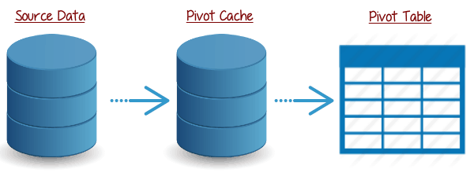
Pivot Cache
Excel takes a snapshot of the data and stores it in its memory. This snapshot is called the Pivot Cache.
When you create different views using a Pivot Table, Excel does not go back to the data source, rather it uses the Pivot Cache to quickly analyse the data and give you the summary/results.
Pivot Cache enables this fast functioning of a pivot table.

Slide 3
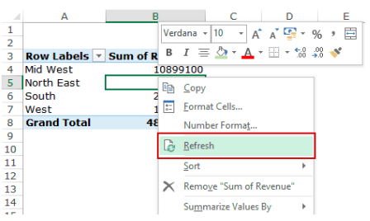
Forcing Pivot Cache Update
You need to force a refresh every time there are changes. Once you force a refresh, the Pivot Cache gets updated, which is reflected in the Pivot Table.
Right-click on any cell in the PivotTable
Select Refresh

Slide 4
Pivot Table Tools
In the worksheet containing a PivotTable, the Ribbon will contain the PivotTable Tools, with ANALYZE and DESIGN Tabs.
The ANALYZE tab has several commands that will enable you to explore the data in the PivotTable.
The DESIGN tab commands will be useful to structure the PivotTable with various report options and style options.

Slide 5
ANALYZE Commands
The commands on the Ribbon of ANALYZE tab include the following:
Expanding and Collapsing a Field.
Grouping and Ungrouping Field Values.
Active Field Settings.
PivotTable Options.

Slide 6
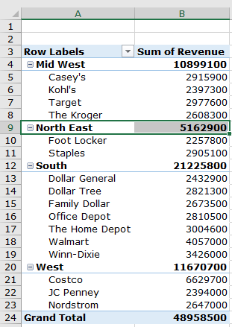
Expanding and Collapsing a Field
1. ExpandCollapse.xlsx
If you have nested fields in your PivotTable, you can expand and collapse a single item.

Slide 7
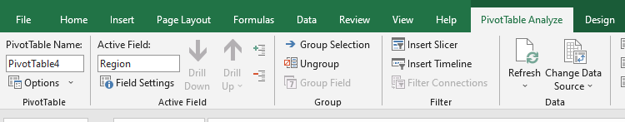
Expanding and Collapsing a Field
Or you can expand and collapse all the items of the active field.
Click any of the items of the field – Region.
Click the ANALYZE tab on the Ribbon.
Click Collapse Field in the Active Field group.

Slide 8
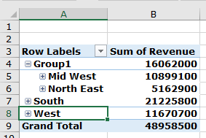
Grouping and Ungrouping Field Values
2. Group.xlsx
You can group and ungroup field values to define your own clustering. For example, you might want to know the data combining Mid West and North East regions.
Select the Mid West and North East items of the Region field in the PivotTable.
Click the ANALYZE tab on the Ribbon.
Click Group Selection in the group – Group.

Slide 9
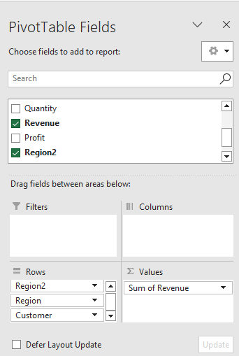
Grouping and Ungrouping Field Values
The items – Mid West and North East are grouped under the name Group1.
You can also observe that a new field – Region2 is added in the PivotTable Fields list, which appears in the ROWS area.

Slide 10
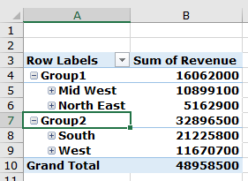
Grouping and Ungrouping Field Values
The items – South and West are grouped under the name Group2.

Slide 11
Grouping and Ungrouping Field Values
To ungroup a group, do the following
Click on the Group Name.
Click the ANALYZE tab.
Click Ungroup in the group – Group.

Slide 12
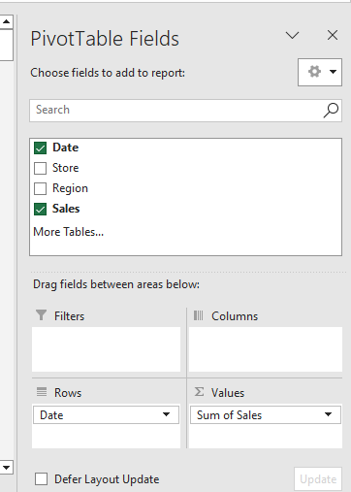
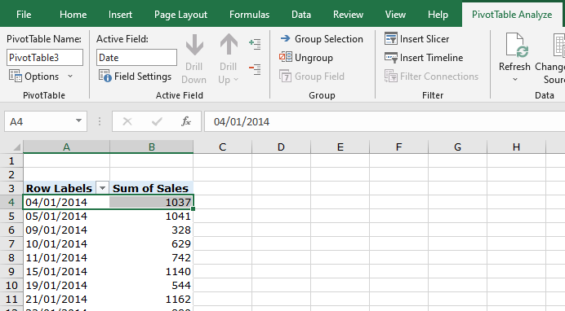
Grouping by a Date Field
3. Group-Dates.xlsx
Insert Pivot Table with Ungroup option.

Slide 13
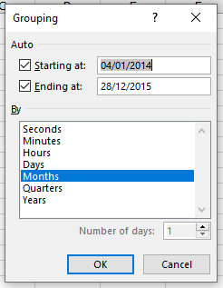
Grouping by a Date Field
Click on a Date item in the PivotTable.
Click the ANALYZE tab on the Ribbon.
Click Group Field in the group – Group.
The Grouping dialog box appears.
Set the dates for – Starting at and Ending at.
Select Months, Quarters and Years in the box under By. To select / deselect multiple items, keep the Ctrl-key pressed.
Click OK.

Slide 14
Exercise 1
We want to analyse store sales or website traffic a weekly basis. We know that the starting date January 4, 2014 is a Saturday. So the grouping would be from Saturday to Friday every week.
Create a pivot table showing weekly sales.

Slide 15
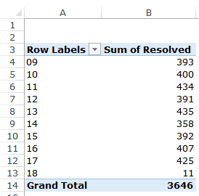
Exercise 2
The file given is the call center data.
Create a pivot table showing hourly calls as shown.

Slide 16
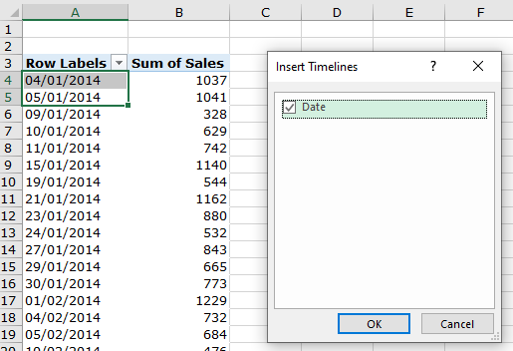
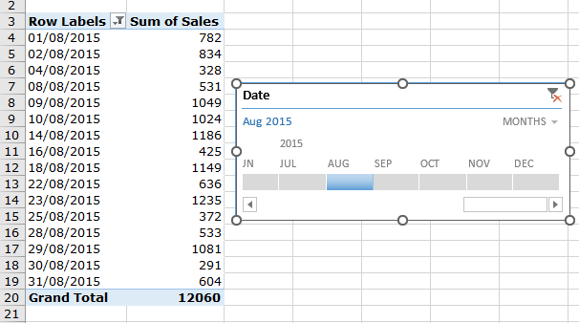
Timeline Slicer
6. Timeline Slicer.xlsx
Timeline slicer is designed to work exclusively with date fields, and it provides an excellent visual method to filter and group the dates in a pivot table.

Slide 17
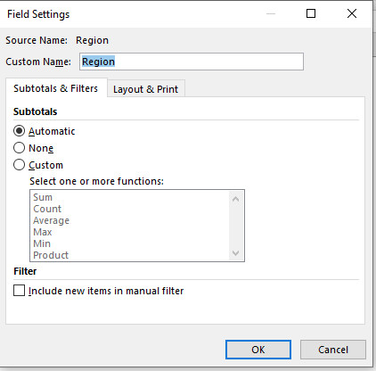
Active Field Settings
7. FieldSetting.xlsx
Suppose you want to set Active Field as the Region field.
Click on Mid West.
On the Ribbon, in the Active Field group, in the Active Field box, Region will be displayed.
Click on Field Settings. The Field Settings dialog box appears.
You can set your preferences for the field – Region.

Slide 18
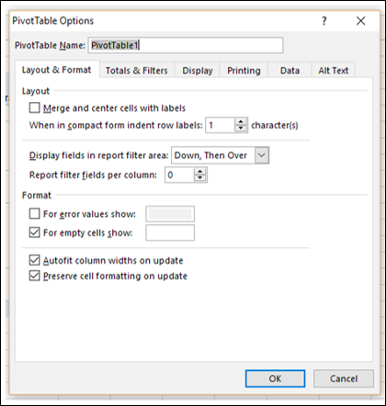
PivotTable Options
You can set the PivotTable Options according to your preferences.
Click on the PivotTable.
Click the ANALYZE tab.
Click Options in the PivotTable group.
The PivotTable Options dialog box appears. You can set your preferences in the dialog box.

Slide 19
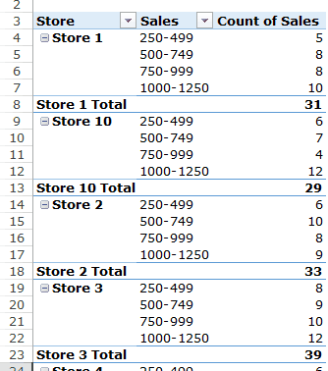
Group Numbers in Pivot Tables
8. GroupNumber.xlsx
We want to create a Pivot Table that shows the frequency distribution of the number of sales transactions within the groups that we created as shown.

Slide 20
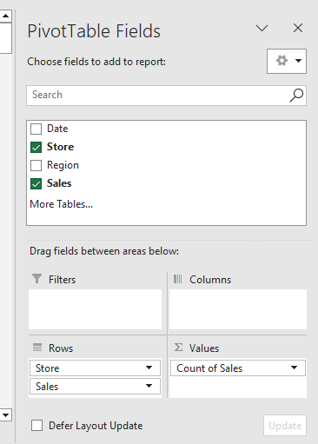
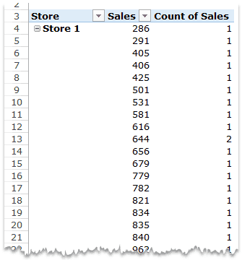
Group Numbers in Pivot Tables
We set a pivot table as shown.
Note that the values column has COUNT instead of SUM. This can be made by changing the value field settings of the Sales value to display COUNT

Slide 21
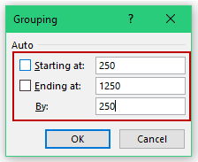
Group Numbers in Pivot Tables
Select any cells in the row labels that have the sales value.
Go to Analyze –> Group –> Group Selection.
In the grouping dialog box, specify the Starting at, Ending at, and By values. In this case, By value is 250, which would create groups with an interval of 250.
Click OK.
Try moving the grouped sales to the column area.

Slide 22
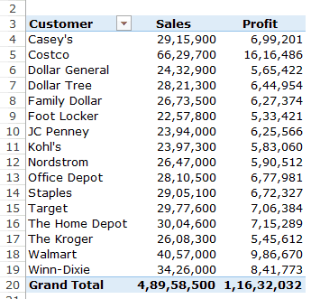
Calculated Fields in Pivot Tables
9. CalculatedFields.xlsx
In a pivot table, you can create calculated fields, using your own custom formulas in terms of the other pivot fields.
Suppose you have a Pivot Table as shown below and you want to calculate the profit margin for each retailer:

Slide 23
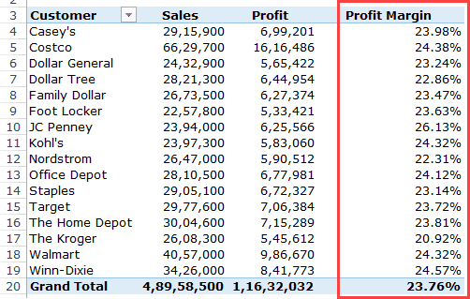
Calculated Fields in Pivot Tables
You want to add Profit Margin (Profit/Sales) to the table.

Slide 24
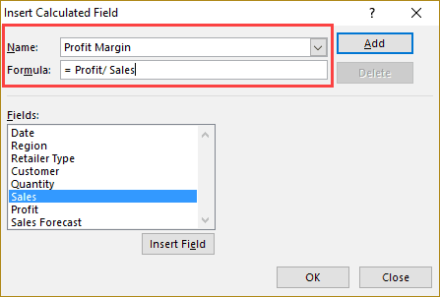
Calculated Fields in Pivot Tables
Select any cell in the Pivot Table.
Go to Pivot Table Tools –> Analyze –> Calculations –> Fields, Items, & Sets.
From the drop-down, select Calculated Field.
In the Insert Calculated Filed dialog box:
Click on Add and close the dialog box.

Slide 25
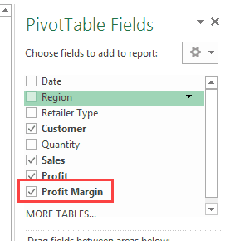
Calculated Fields in Pivot Tables
As soon as you add the Calculated Field, it will appear as one of the fields in PivotTable Fields list.
Now you can use this calculated field as any other Pivot Table field (note that you can not use Pivot Table Calculated Field as a report filter or slicer).
You can edit a formula of Profit Margin.
What is the formula of Sales Forecast?

Slide 26
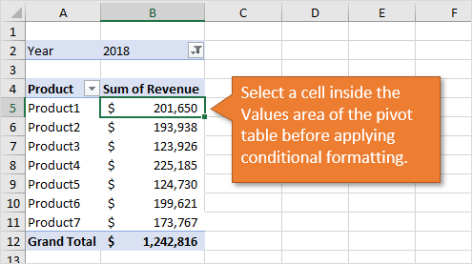
Conditional Formatting in Pivot Tables
10. ConditionalFormatting.xlsx
Setting up conditional formatting for pivot tables is a little different than it is for regular cells/ranges.
1. Select a cell in the Values area

Slide 27
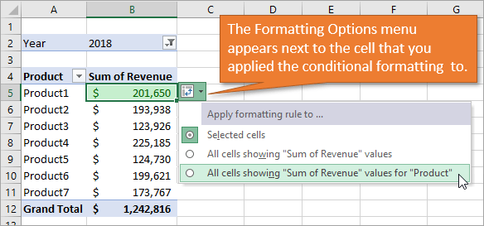
Conditional Formatting in Pivot Tables
Setting up conditional formatting for pivot tables is a little different than it is for regular cells/ranges.
2. Apply Conditional Formatting
We want to show the highest three. Once cells are formatted, Formatting Options menu appears by the conditional formatting cell

Slide 28
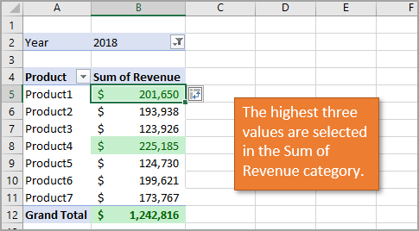
Conditional Formatting in Pivot Tables
Setting up conditional formatting for pivot tables is a little different than it is for regular cells/ranges.
3. Using the Formatting Options Menu
You can use the Formatting Options menu to apply the formatting to the field in the Values area.
Choosing the second option in the menu applies the formatting rule to any of the values under the “Sum of Revenue” heading, including the Grand Total.

Slide 29
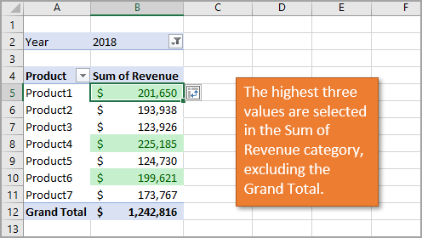
Conditional Formatting in Pivot Tables
Setting up conditional formatting for pivot tables is a little different than it is for regular cells/ranges.
3. Using the Formatting Options Menu
If you want to exclude the Grand Total, you can choose the third option in the Formatting Options menu: All cells showing “Sum of Revenue” values for “Product.”

Slide 30
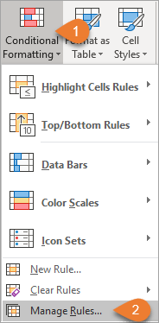
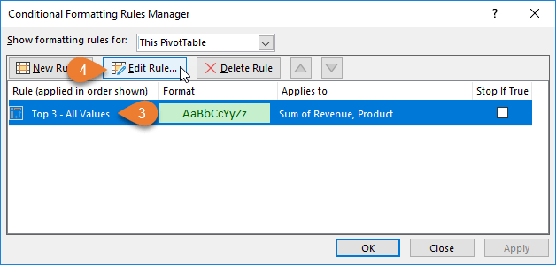
Conditional Formatting in Pivot Tables
Setting up conditional formatting for pivot tables is a little different than it is for regular cells/ranges.
4. Accessing the Formatting Options After You've Made Changes

Slide 31
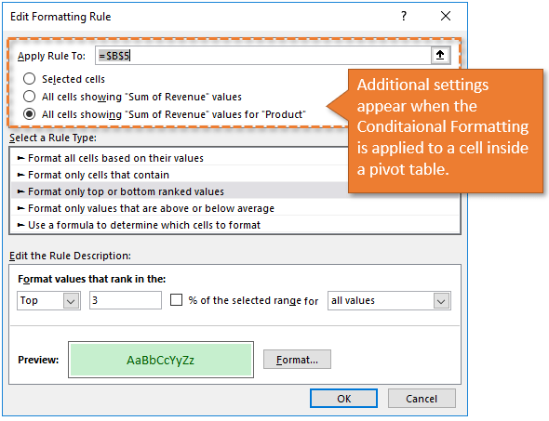
Conditional Formatting in Pivot Tables
Setting up conditional formatting for pivot tables is a little different than it is for regular cells/ranges.
4. Accessing the Formatting Options After You've Made Changes
This brings up the Edit Formatting Rule window. The top of the window lists the same options that appeared in our menu.

